Slide 1
“Innumeracy: Mathematical Illiteracy and its Consequences”
Barbara Luckett
November 10th 2009

Slide 2
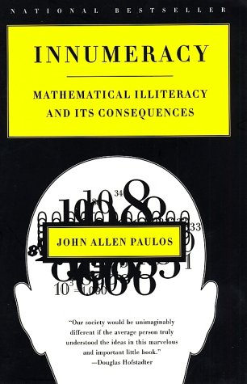
Primary Source
Paulos, John Allen. Innumeracy: Mathematical Illiteracy and its Consequences. New York: Hill and Wang, 1988.
Required reading for UVA Masters of Systems Engineering course
Takes concept of math phobia to new level of “innumeracy” and examines the implications this can have on society

Slide 3
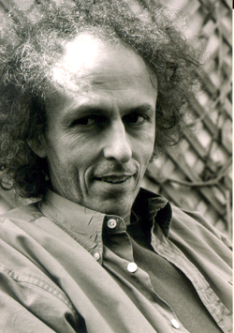
John Allen Paulos
Born July 4th, 1945
Received his Ph.D. in Mathematics from the University of Wisconsin – Madison
Professor of Mathematics at Temple University in Philadelphia
Author of multiple books on mathematical literacy
Writes the Who’s Counting column for ABCnews.com

Slide 4
What is “Innumeracy?”
Phrase coined by cognitive scientist Douglas Hofstadter
Similar concept to illiteracy, but with numbers rather than words
Unfamiliar with, or unable to use, mathematical concepts and methods
“ Innumeracy, an inability to deal comfortably with the fundamental notions of number and chance, plagues far too many otherwise knowledgeable citizens.” – page3
Compared to other flaws (which are often hidden), innumeracy is often flaunted…

Slide 5
Misconceptions about Mathematics
Math is purely computational
Just as writing is more than typing skills…
Problems result from insufficient exposure to mathematical thought processes rather than inability to compute
Math is completely hierarchical
Some mathematical topics certainly build on others, but this is often less important than one would think
Many sophisticated mathematical ideas can be taught to someone with limited prior math knowledge

Slide 6
Misconceptions about Mathematics
Storytelling isn’t an effective educational tool for mathematics
People assume that there isn’t any overlap between numbers and words, but numbers appear in real-world contexts…
Math is only for the few
Of course, math will come easier to some than others
But everyone can (and should) have a working knowledge of mathematics
Math numbs us or limits our freedom in some way
Life and love vs. numbers and minute details

Slide 7
Innumeracy Examples…
“Ben and I are going to drive to Colorado. Airplanes are so unsafe these days.”
A doctor warns a patient about the side effects of a certain surgery twice; once saying the procedure is “99% safe” and again saying it has a “one chance in a million risk.”
“Bad things always come in threes. Take the death of Ed McMahon, Farrah Fawcett, and Michael Jackson for instance.”
A man who travels a lot was concerned about the probability of a bomb being on his plane, so he carried one on board: he reasoned that the probability of having two bombs on the plane is extremely minuscule.
“A million, a billion, a trillion, whatever… It doesn’t matter as long as we do something about it.”

Slide 8
Outline of Topics and Examples
Understanding/visualizing large numbers
Estimation Problems
How Much is $1 Trillion?
Comparing probabilities of different events
Gambler’s Fallacy
Monty Hall Problem
Birthday Paradox
Consequences, Causes, and Conclusions

Slide 9
Classic Estimation Problem
Classic contest of estimating how many gumballs are in a jar…
Group of physicists at NYU recently developed a statistical model
Solution is found in how the particles pack in terms of how many neighboring gumballs a single gumball can randomly touch within the container
Results can be used in a variety of industry packing scenarios
http://www.nypost.com/p/news/regional/gumball_stumper_solved_at_nyu_T8DrvACj9zZh4pxgw28pgL

Slide 10
Larger Scale Estimation Problem
What is the volume of all the human blood in the world?
The average adult male has ≈ 6 quarts of blood
Women have slightly less, children have considerably less
If each of the 5 billion people in the world (number from Innumeracy book ≈ 1988) has 1 gallon of blood
That’s 5 billion (5 x 10⁹) gallons of blood
There are about 7.5 gallons /cubic foot
Approximately 5 x 10⁹ / 7.5 = 6.7 x 10⁸ cubic feet of blood
Take the cube root of 6.7 x 10⁸ , which gives us 870 feet
So, all of the human blood in the world would fit into a cube 870 feet on each side

Slide 11
Larger Scale Estimation Problem
Consider Central Park:
Area of about 1.3 square miles
If walls were built around the entire park and all of the world’s human blood was poured in, it would fill to a depth of…
Just under 2o feet!
Consider the Dead Sea:
Area of 390 square miles
If all the world’s human blood was poured in, it would add to the depth by….
Only ¾ of an inch!

Slide 12
“Million,” “Billion,” “Trillion” in the news:
Federal Deficit Hits $1.42 Trillion High by Martin Crutsinger (AP) Friday, Oct. 16, 2009 http://www.time.com/time/business/article/0,8599,1930829,00.html
“The federal budget deficit has surged to an all-time high of $1.42 trillion…”
“The Obama administration projects deficits will total $9.1 trillion over the next decade unless corrective action is taken.”
“Government spending last year jumped to $3.52 trillion, up 18.2 percent over 2008. The $700 billion financial bailout fund and increased spending and tax relief from the $787 billion economic stimulus program…”

Slide 13
“Million,” “billion,” and “trillion” often get grouped together because they are easily recognized and they rhyme
Our numbering system makes it easy to write out large numbers
1,000,000,000,000 vs. 1,000,000,000 vs. 1,000,000
But those extra zeros make a HUGE difference
1 million seconds = _______ days
1 billion seconds = _______ years
1 trillion seconds = _______ years
“I like to say that I have a pretty good idea what I'll be doing a million seconds from now, no idea what I'll be doing a billion seconds from now, and an excellent idea of what I'll be doing a trillion seconds from now.” – David Schwartz, author of children's book How Much Is a Million?
11.5
32
32,000

Slide 14
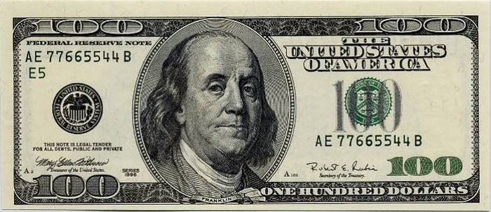
So, How Much is $1 Trillion?
http://www.youtube.com/watch?v=oPfY0q-rEdY
http://www.youtube.com/watch?v=at3MNu8BRwQ
6

Slide 15
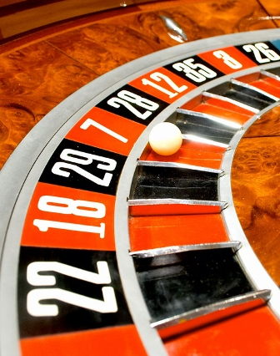
Roulette: Gamblers’ Fallacy
If the wheel has come up red on the last 10 spins:
Assuming we have an unbiased wheel, do you bet on red or black for the next spin?
Use past results as a guide for the future and bet on red?
Or bet on black because it’s due?
Less likely to get 11 reds in row than to get 1 black and 10 reds (in any order)
But we are equally likely (or equally unlikely) to get either RRRRRRRRRRR or RRRRRRRRRRB

Slide 16
Monty Hall Problem
“Let’s Make A Deal” was a popular game show in the 60’s and 70’s hosted by Monty Hall
Basic premise is that a game show contestant is presented with three doors – one of which has a new car behind it; the other two have booby prizes (goats) behind them
The contestant picks one of the three doors, Monty Hall then opens one of the remaining two doors (being careful not to reveal the car), and then offers the contestant the chance to switch doors
Critical assumptions are that the car is randomly placed behind a door (each door has an equal chance of having the car behind it) and the host will always offer you the chance to switch
Should the contestant switch?

Slide 17
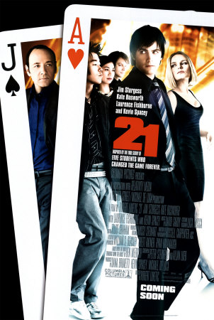
Monty Hall clip from 21
http://www.youtube.com/watch?v=dciSc2rPSjE&feature=related

Slide 18
Many people will reason that it doesn’t matter
Since there are two possibilities, the probability of winning with either choice is 1/2
However, If the contestant selects Door #1:
1/3 (1/6 + 1/6) chance of winning the car if you stay as compared to a 2/3 chance of winning if you switch
Car Location: Host opens: Probability: Stay: Switch:
Door #1
Door #2
Door #3
Door #2 or Door #3
Door #3
Door #2
1/6
1/6
1/3
1/3
Car
Car
Goat
Goat
Goat Goat
Car
Car

Slide 19
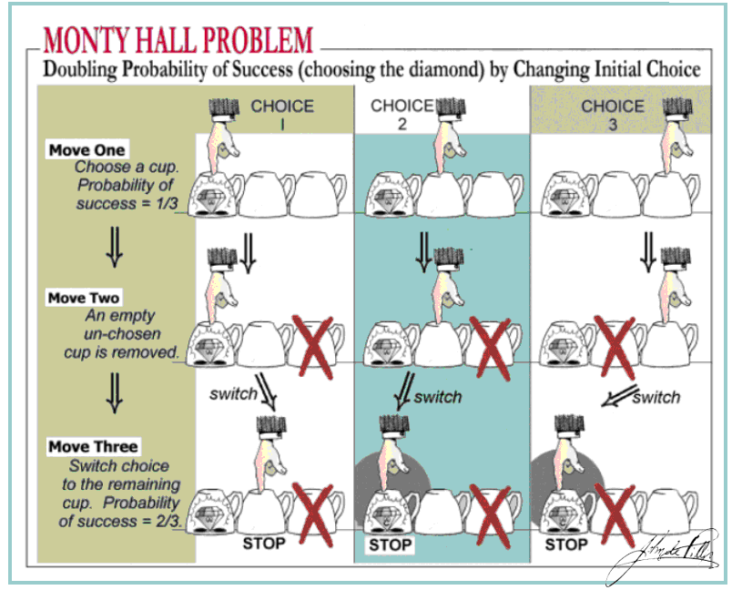
http://math.ucr.edu/~jdp/Monty_Hall/Monty_Hall_a.GIF

Slide 20
Monty Hall Problem revisited
One way to make this more intuitive is a slight variation with 100 doors (a car behind one and goats behind the remaining 99)
Again, you pick one door
The host opens 98 doors (being careful to not open the door with the car behind it) and gives you the choice to switch
Should you?
The fact that switching is the correct choice should be more obvious in this case, but many people still refuse to switch
Emotion and fear of regretting switching if original choice was correct

Slide 21
Birthday Paradox
Looks at the probability that a pair of people in a randomly selected set of people will share a birthday
Probability is greater than 50% when you have a group of at least 23 randomly chosen people
Probability is more than 99% when you have 57 or more people and will hit 100% when you have 366 people by the pigeonhole principle (ignoring leap years)
This is counter-intuitive for a lot of people
Since there are 365 possible birthdays, many will assume you need 182.5 people (50% of 365) to be 50% sure of a pair

Slide 22
Birthday Paradox Probability
Define A as the event where you have a pair of people who share a birthday
Let P(A^{c}) = P(1) x P(2) x P(3) x … x P(23)
Where P(2) = probability that person #2 has a different birthday than person #1 …
P(A^{c}) = 365/365 x 364/365 x 363/365 x … x 343/365
P(A^{c}) = (1/365)²³ x (365 x 364 x 363 x … x 343)
365! = 365 x 364 x … x 343 x 342!
365 x 364 x 363 x … x 343 = 365!/342!
P(A^{c}) = (1/365)²³ x (365!/342!) = 0.49270276
P(A) = 1 – P(A^{c}) = 1 − 0.49270276 = 0.507297

Slide 23
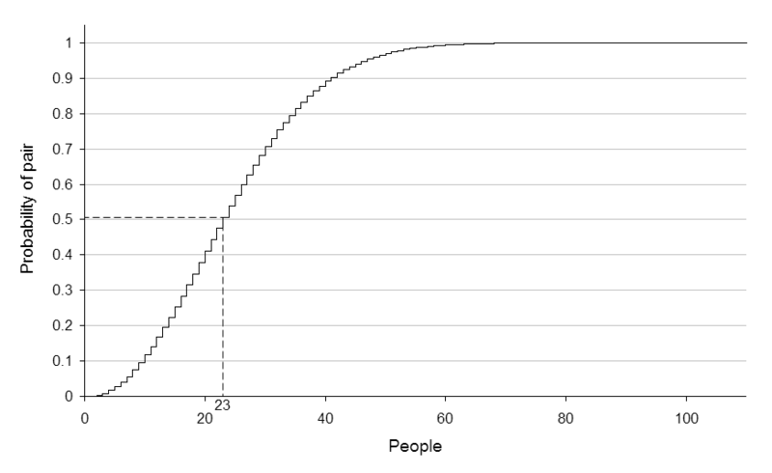
Birthday Paradox Probability
http://en.wikipedia.org/wiki/Birthday_problem

Slide 24
Case in point…
Looking at the list of Australian Prime Ministers: the 24th Prime Minister is the first to share a birthday with another on the list.
James K. Polk (11th president) and Warren G. Harding (29th president) were both born on November 2nd
Of the 73 male actors to win the Academy Award for Best Actor, there are six pairs that share a birthday
Of the 67 actresses to win the Academy Award for Best Actress, there are three pairs of actresses who share a birthday (http://en.wikipedia.org/wiki/Birthday_problem)
Went through Facebook friends randomly – I had my first match on the 39th person and my second on the 45th person

Slide 25
Birthday Paradox Comparison
Define B as the event where someone else in the room of n people shares a birthday with you
P(B) = 1 – (364/365)^{n}
Plugging in n = 23 gives us a probability of 6.1%
In order to get a greater than 50% chance, we need n = 253
This difference came up on the Johnny Carson show…
‘Some unlikely event’ is actually fairly likely to occur where it is much less likely that any ‘particular unlikely event’ will

Slide 26
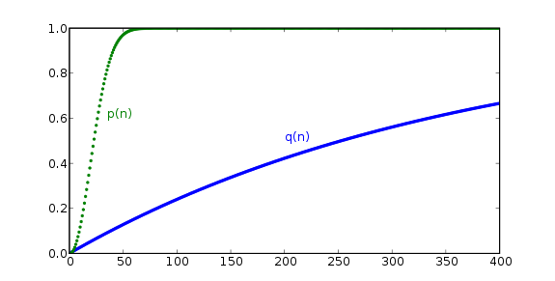
Birthday Paradox Comparison
Original Birthday Paradox:
p(n) = probability of a match
Same Birthday as You Problem:
q(n) = probability of a match with you
http://en.wikipedia.org/wiki/Birthday_problem

Slide 27
Media’s Role in Innumeracy
Statistics reported out of contexts
Knowing only that a company lays off 10 employees doesn’t tell you much
Company of 10,000 or 30?
Covering a situation out of proportion with its occurrence
Makes incredibly rare events appear common
Covering murder as compared to lung cancer deaths
World News is worse than National News which is worse than Local News
With a large enough sample space, it’s unlikely that unlikely events will not happen
“Nothing ever happens here!”

Slide 28
Consequences of Innumeracy
Inability to accurately perform basic calculations
Estimations, measurements, percentages, etc…
Poor assessment of risk
Taking unnecessary risks while attempting to select safer alternative
Improperly allocating resources based on perceived need
Fewer job prospects or a lower salary
Financial mismanagement
Accumulation of debt
Losing money in a gambling scenario
Not taking advantage of compound interest
Misinformed decisions

Slide 29
Innumeracy in critical decision making…
Example from Judgement Under Uncertainty: Heuristics and Biases by Tversky, Slovic, and Kahneman
You are a general of a 600-person army surrounded by enemy forces, and you have two possible escape routes:
Will save 200 soldiers
Probability of 1/3 that all 600 will make it out alive and 2/3 that none will
3 out of 4 people choose route #1, since 200 people can definitely be saved as compared to the 2/3 chance that route #2 will result in more deaths

Slide 30
But, what if we re-phrase the question??
Again, you are a general of a 600-person army surrounded by enemy forces, and you have two possible escape routes:
400 of your soldiers will die
Probability of 1/3 that none will die and 2/3 that all 600 will die
Now, 4 out of 5 people faced with this decision choose route #2 , since it gives us a 1/3 chance that everyone will get out alive, while route #1 will lead to 400 deaths
People tend to avoid risk when seeking gains, but choose risk when trying to avoid losses

Slide 31
Why is innumeracy so widespread? 1) Poor Education
Teachers aren’t sufficiently capable or they have little or no interest/appreciation for mathematics
Many of the few mathematically talented people go into higher paying fields rather than teaching
Many curriculums focus solely on computational aspects rather than conceptual examples
Focused on teaching to the test
Students lose interest and rule out math classes
Quality of education improves at the college and graduate levels but for many it’s too little too late

Slide 32
Why is innumeracy so widespread? 2) Psychological factors
Society’s perceived value of math
Richard Cohen’s What is the Value of Algebra? Column in the Washington Post in 2006
“You will never need to know algebra. I have never once used it … You will never need to know -- never mind want to know -- how many boys it will take to mow a lawn if one of them quits halfway and two more show up later… Most of math can now be done by a computer or a calculator. On the other hand, no computer can write a column or even a thank-you note -- or reason even a little bit.”
http://www.washingtonpost.com/wp-dyn/content/blog/2006/02/15/BL2006021501989.html
Negative portrayal of math in popular culture forms
Math anxiety or math phobia
Cycle of not understanding the material, feelings of frustration and failure, eventually leading to giving up…

Slide 33
Conclusions
“I’m distressed by a society which depends so completely on mathematics and science and yet seems so indifferent to the innumeracy and scientific illiteracy of so many citizens; with a military that spends more than one quarter of a trillion dollars each year on smarter weapons for ever more poorly educated soldiers; and with the media, which invariably becomes obsessed with this hostage on an airliner, or that baby who has fallen into a well, and seems insufficiently passionate when it comes to addressing problems such as urban crime, environmental deterioration, or poverty.” – page 178

Slide 34
Conclusions
Mathematics is everywhere in our day-to day lives…
Art
Games/Sports
Finance
Business
Politics/Voting
People need to be able to look at real-world scenarios quantitatively in order to accurately assess them and make good decisions

